Slide 1

UAV Project Proposal | 2025
UAV PATH PLANNING BASED ON ARTIFICIAL BEE COLONY ALGORITHM
Presented by:
Aditya Raj Singh (2022102067)
Aarnav Nagariya (2021112017)

Slide 2

OBJECTIVE
The Objective of this project is to develop an efficient, non-deterministic bidirectional UAV path-planning algorithm using the Artificial BEE colony (ABC) algorithm.
The UAV must navigate complex environments while :
✅ Minimizing total travel distance and avoiding obstacles and threats
✅ Maintaining smooth trajectory transitions
✅ Ensuring altitude constraints are met
The path planning problem is treated as an optimization problem, where the best path is selected based on a cost function incorporating distance, angle smoothness, altitude constraints, and threat avoidance.
Finally, Implement and validate the approach using MATLAB or Python simulations.

Slide 3

SOLUTION APPROACH
A. UAV Path Representation:
The UAV's path is represented as a series of waypoints in a 3D environment (x, y, z coordinates).
The path is discretized into candidate positions, and each solution is a potential set of waypoints.
B. Why Artificial Bee Colony (ABC) Algorithm?
ABC is a swarm intelligence-based optimization technique inspired by the food-foraging behaviour of honeybees which consists of 3 types of bees:
Employed Bees: Exploit food sources (solutions) and share information.
Onlooker Bees: Select the best solutions based on fitness and improve them.
Scout Bees: Explore new solutions by replacing poor ones with random searches.
It balances exploration (global search) and exploitation (local optimization), making it ideal for path planning in dynamic environments.
The bidirectional planning mechanism enhances efficiency by simultaneously optimizing paths from start and destination points.

Slide 4
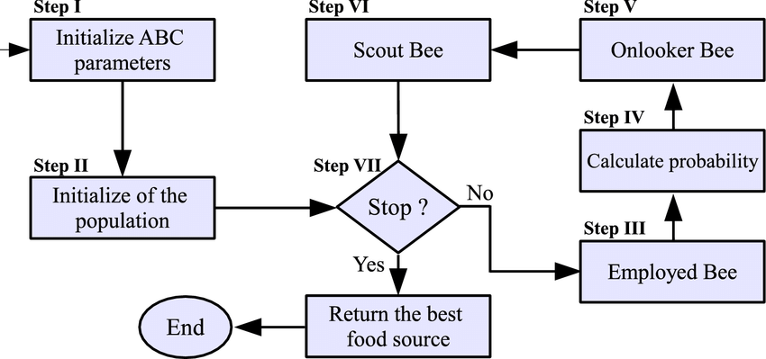
SOLUTION APPROACH

Slide 5
SOLUTION APPROACH
C. Steps in Path Planning Using ABC Algorithm:
Environment Modeling:
Define the UAV's operating environment using appropriate models for obstacles and waypoints.
Path Search Optimization:
Apply a non-deterministic bidirectional search to generate and refine paths in both forward and reverse directions.
Food Production Optimization:
Modify the ABC algorithm’s food production process to improve path selection.
Simulation & Validation:
Implement the algorithm in MATLAB and test it under different terrain and obstacle conditions..

Slide 6
DELIVERABLES
Simulations
Implementation of the ABC-based UAV path planning algorithm in MATLAB or Python.
Testing in various environmental scenarios to evaluate efficiency.
3D Path Visualization: Display UAV trajectory with obstacles, threats, and altitude constraints.
Threat Avoidance: Show UAV navigating around danger zones.
Performance Analysis
Comparison with conventional path-planning methods.
Metrics: path length, computation time, obstacle avoidance efficiency.
Final Report & Presentation
Documentation of methodology, simulation results, and key findings.
Discussion of potential future enhancements, including multi-UAV path planning.

Slide 7
UAV Project Proposal | 2025
THANK YOU

